Slide 1
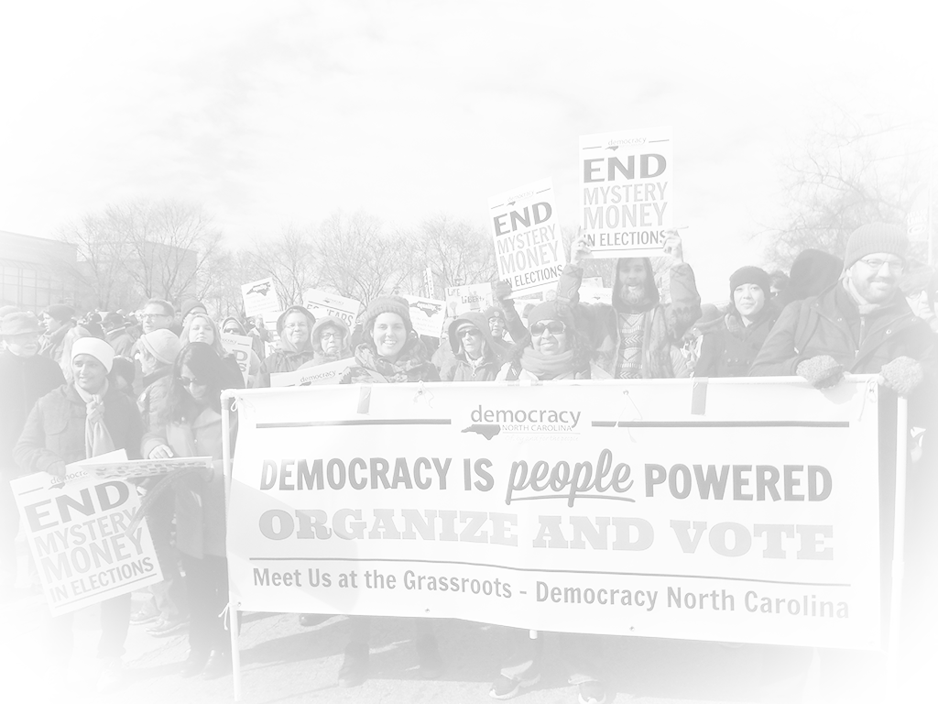
Voter Registration
Democracy NC

Slide 2
Democracy NC Mission
Research, Organizing, Advocacy
Increase voter participation
Decrease big money influence
Government of, by & for the people

Slide 3
Agenda for Today

Slide 4
Voter registration basics
Practice!
Important tips
Questions and answers
Wrap up

Slide 5
Why Did You Come?

Slide 6
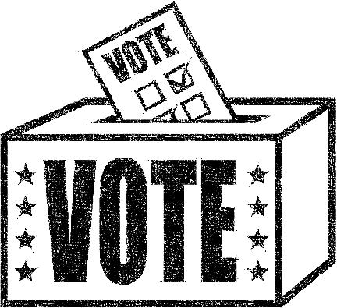
Voter Registration
Basics….

Slide 7
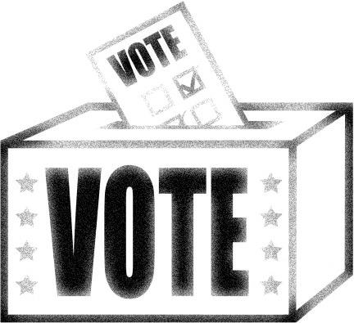
Who Can Register to Vote?
US Citizen
18 by Election Day
Not currently serving felony sentence
Living in the county for 30 days

Slide 8
Who Can Register Someone to Vote?
Anyone can help an eligible person register to vote.

Slide 9
Voting “Registrars”
Help and provide information.
Make people feel comfortable.
Be non-partisan.
Turn in the form!

Slide 10
How It Works
Voter completes registration form
Send form to local elections board
Elections board verifies identity
Voter is contacted:
Receives Voter Registration Card OR
Receives request for more info
Notes:
You can help them, but they must sign

Slide 11
How It Works
Deadline to Register--
25 Days before Election
February 19, 2016
October 14, 2016
Notes:
You can help them, but they must sign

Slide 12
Exception to Deadline
Move within your county:
Update voter registration address during Early Voting period
On Election Day, vote in the new precinct and ask for a “transfer”

Slide 13
Questions
About how it works?

Slide 14
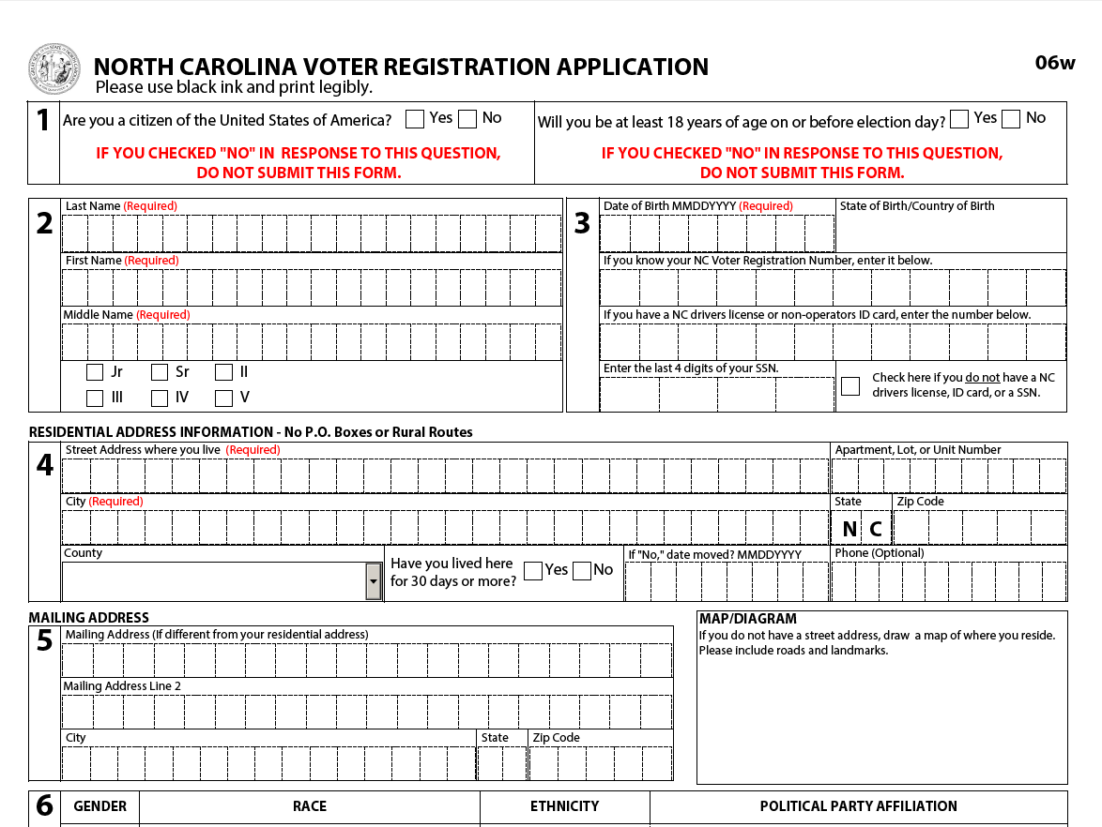
The Form

Slide 15
Filling Out the Form: Required Sections
Checkboxes Section 1
Notes:
We want you to be like this!

Slide 16
Filling Out the Form: Required Sections
Full Legal Name Section 2

Slide 17
Filling Out the Form: Required Sections
Date of Birth Section 3

Slide 18
Filling Out the Form: Important – ID Numbers
NC driver’s license
NC ID
Last four of SSN
Notes:
Important because helps verify identity
If no ID # is listed, you’ll be required to show an identifying document when you first vote
Focus voter’s attention on Section 3 and check the box if they have no ID #

Slide 19
Filling Out the Form: Required Sections
Residential Address Section 4

Slide 20
Filling Out the Form: Required Sections
Signature Line

Slide 21
Filling Out the Form: Other key sections
Phone number
Follow up and Get Out the Vote
Race, Gender & Ethnicity
Helps monitor the political process for bias
Previous Registration
At least city, county and state
Notes:
We want you to be like this!

Slide 22
Important Tip
You cannot ask someone to register for any particular party
If you accept a completed form, you must turn it into the county Board of Elections within 7 days.
Forms must be in by 25 day deadline

Slide 23
Important Tip
Make sure the form is filled out correctly before the voter leaves!

Slide 24
Frequently Asked Questions From Voters

Slide 25
What Party Should I Register For?
“You should choose a party that matches your values or you can choose unaffiliated. I’m not allowed to recommend a party.”

Slide 26
What’s the Difference Between Parties?
“You can call or look up the parties online to find out more about their positions.”
Notes:
You can also use an elected official as an illustration.

Slide 27
I’ll be 18 Soon. Can I Register?
If you will be 18 by the General Election, then yes! You can vote in the primary if you’re 17 and will be 18 on the day of the General Election.

Slide 28
What if I Have a Felony Conviction?
Your sentence must be complete (including probation or parole) before re-registering. Re-register like a new voter.
Notes:
Use the same form as anyone else. No special documents required!

Slide 29
What if I Have a Misdemeanor Conviction?
Your right to vote is not affected by a misdemeanor conviction.
Notes:
even if you have served or are currently serving a jail sentence.

Slide 30
What if I Have Pending Felony Charges?
As long as you have not been convicted, you can vote.

Slide 31
What If I Don’t Have a Permanent Address?
Your residence address is where you sleep or spend most of your time.
Your mailing address is where you get mail.
Notes:
Residence Address: If that’s a shelter or a friend’s house, use that address. If you are currently sleeping outside then you need to draw a map describing your sleeping location.
Mailing Address: can be a PO Box, a local shelter, parent’s home
Be sure to update your registration when you move.

Slide 32
I Think I’m Already Registered.
Check your status at demnc.co/myreg
Call the State Board of Elections at (866) 522-4723, or re-register.
Notes:
The new registration will update the old one.
Use your smartphone if you have one to look it up for them.

Slide 33
What Happens After I Register?
You should receive a verification card from the county Board of Elections. You may also get a letter asking for more identifying information.
Notes:
People usually receive letters asking for more information when the Board of Elections can’t verify their identity based on the information on the voter registration form.
Most common if the person doesn’t provide any identifying numbers in Section 3.

Slide 34
What If the Voter is Transgender?
Make sure the name on your ID or Social Security card matches the name on your voter registration.
Notes:
Otherwise, it may derail the verification process.

Slide 35
Other questions?
Call the State Board of Elections at (866) 522-4723.

Slide 36
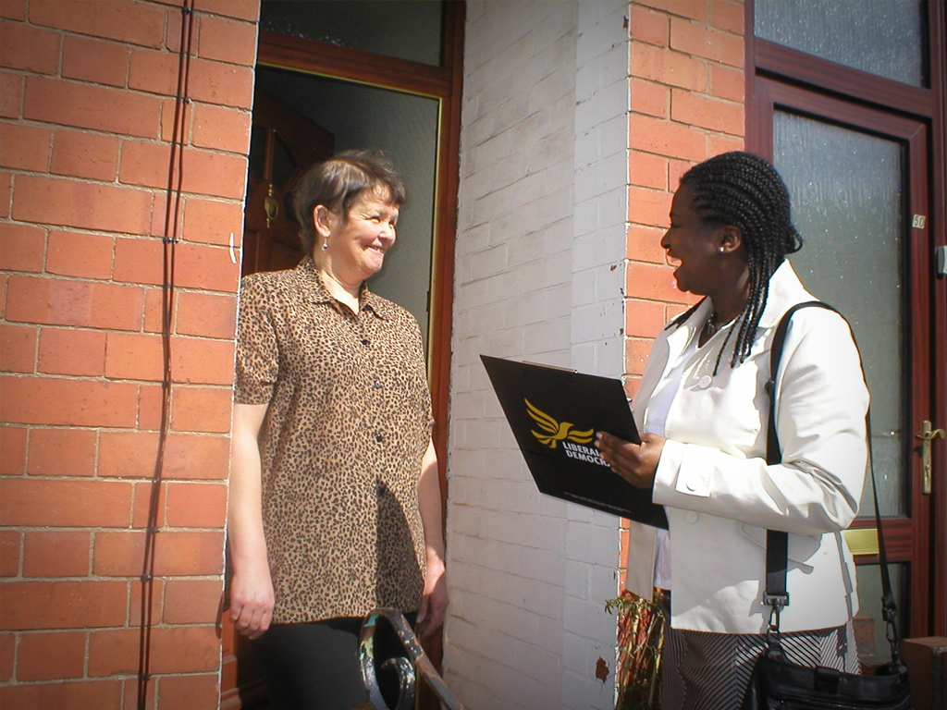
Holding a voter registration drive

Slide 37
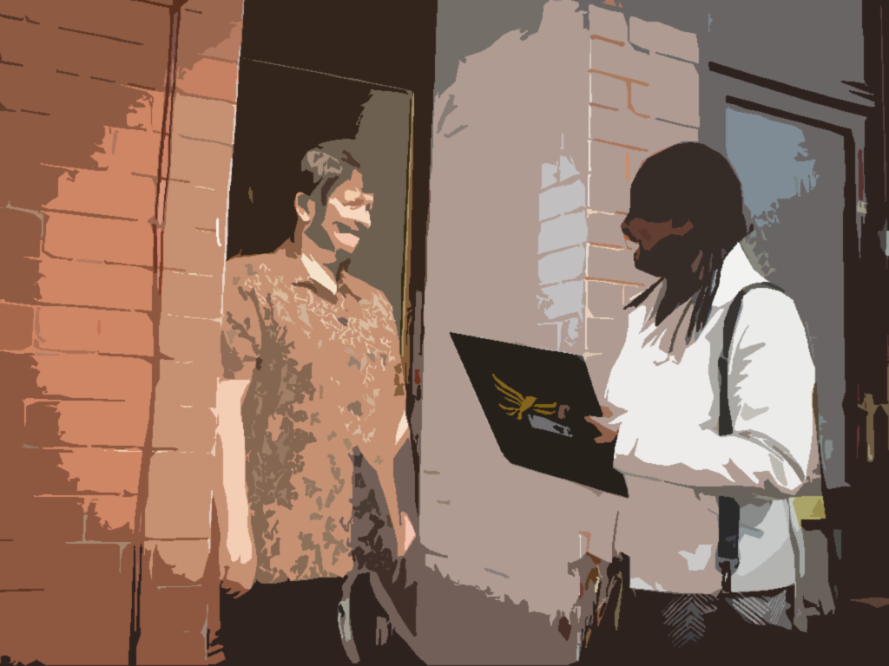
How Will You Register Voters?
Site-based registration
Often results in higher numbers for less effort
Door-to-door registration
Allows you to choose specific areas or neighborhoods
Notes:
Site-Based: means setting up a table at a community event, a store, a church, or other high traffic location.
Door-to-door: means going through a neighborhood.

Slide 38
Making a Plan
Pick a date and time.
Get permission from location sites, if needed.
Work with other groups, if possible.
When going door to door, go in pairs.
Notes:
What days and times are people most likely to be at the site or in the neighborhood you’ve picked?

Slide 39
What to Bring
Voter registration forms & pens (black ink)
Signs “Register to Vote Here” (site based)
Clipboards (especially for door to door)
Nonpartisan voter education materials
Envelope or box for completed forms
Tables and chairs (site based)
Notes:
Pens - (blue and black ink)

Slide 40
Also Consider Bringing
Small things to give away (candy, stickers, or buttons)
Smart phone or laptop to check voters’ status online (if there is WiFi access)
Back-pack or bag with water & snacks
Sunscreen, sunglasses, hat
Notes:
Anything else you need to be comfortable

Slide 41
Coordinating Volunteers
Plan shifts of 3 – 4 hours per volunteer
Could do 2 – 4 for site based
Recruit more volunteers than you need
Send all details in advance
When, where to show up, where to get materials, partner name and contact info, etc.
Notes:
Recruit extra - to account for possible last-minute cancellations. If 10 people say they will come, expect 7 or 8
Teams of two , especially for door-to-door canvassing

Slide 42
Coordinating Volunteers
Provide name and contact info for the leader of the voter registration drive
Call volunteers the night before to confirm their attendance and review all details
Notes:
Make sure that person is available during the day to answer questions, solve problems

Slide 43
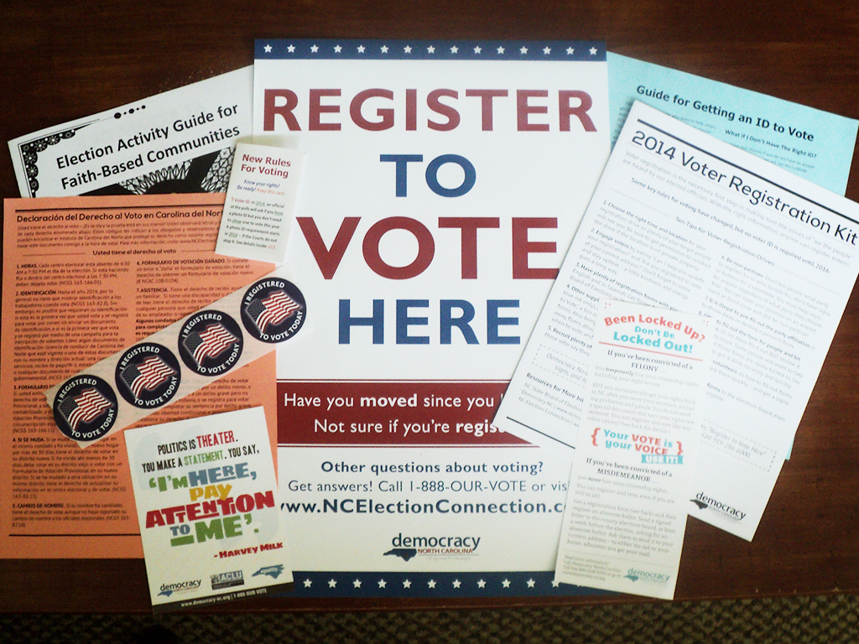
Get what you need…

Slide 44
Questions?
Visit:
democracy-nc.org
ncvoter.com
gotidnc/es/ (en español)
Call:
1-888-OUR-VOTE
(Democracy NC hotline)

